Slide 1
Python Pandas
Binary Operations

Slide 2
Binary operations
Binary operations are the operation where two operands are operated with an operator. Mathematical operator and comparison operator are known as binary operators
add(), sub(), mul(), div() methods perform basic mathematical operation on one or Two DataFrames
radd() and rsub() stand for right side addition and right side subtration. Radd(), and rsub() add and subtract each element in a dataframe with the corresponding element of another data frame
Python Operators | Python Function
+ | add()
- | sub(), subtract
* | mul()
/ | div(), divide()
// | floordiv()
% | mod()
** | Pow()

Slide 3
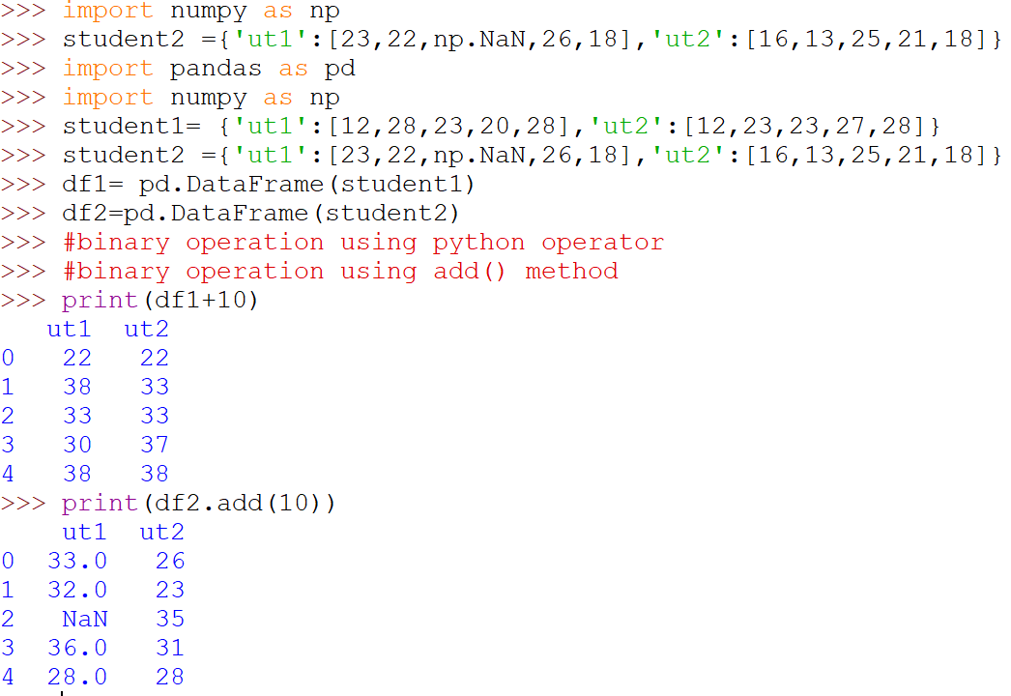
Broadcasting
It is also known as BroadCasting operation. Since 10 is operating with each element of the DataFrame

Slide 4
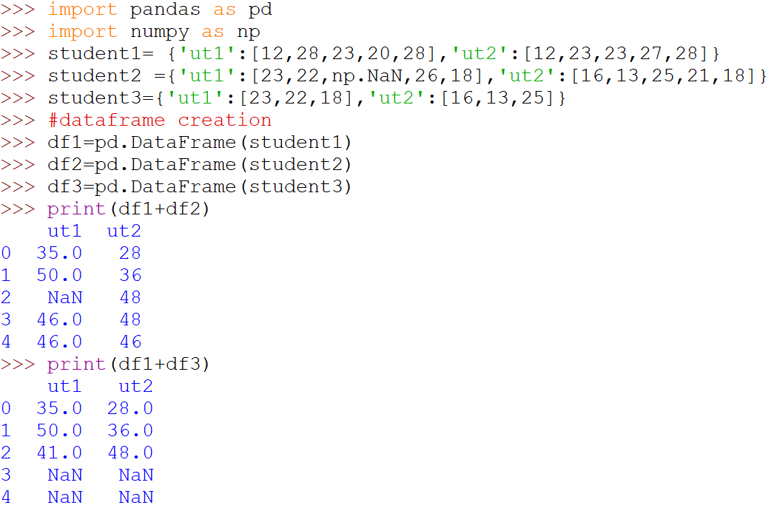
Matching Operation
This type of operation is called MATCHING, since it is adding the corresponding index values of 0,1,2 only and rest is added as NaN

Slide 5
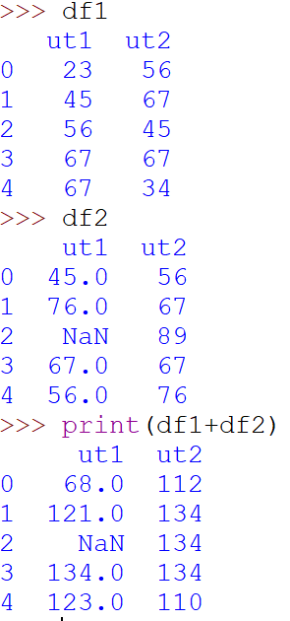
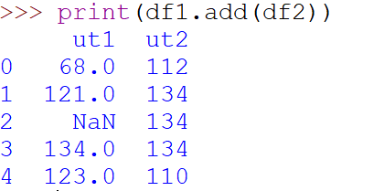
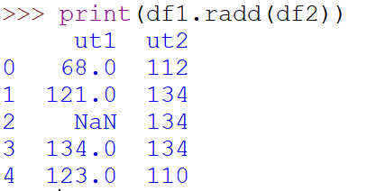
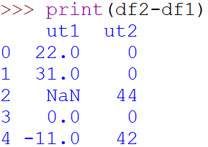
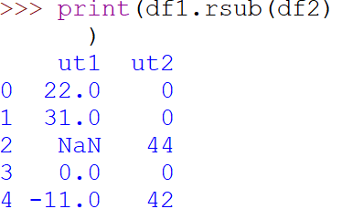
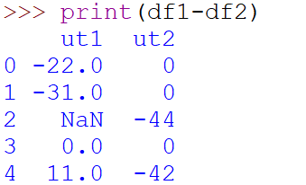
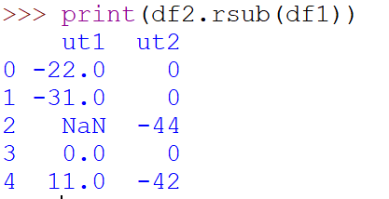
Addition/subtraction/multi/division

Slide 6
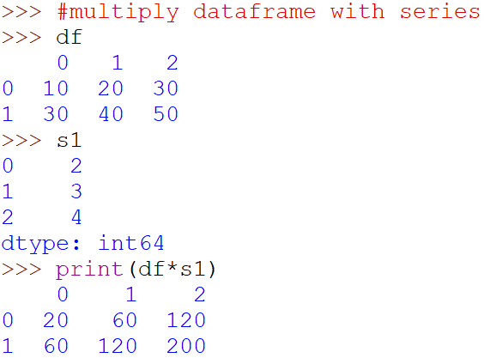
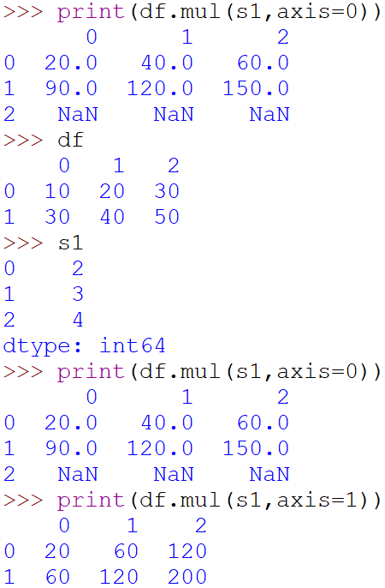
DataFrame multiplication with Series

Slide 7
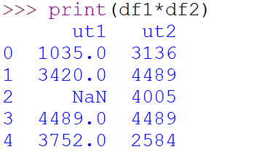
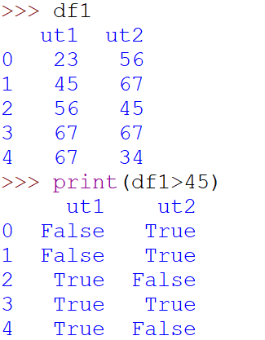
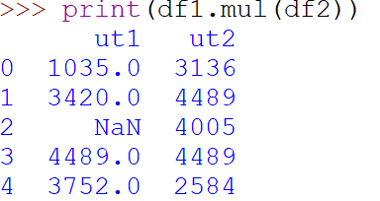
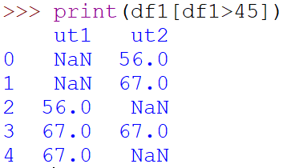
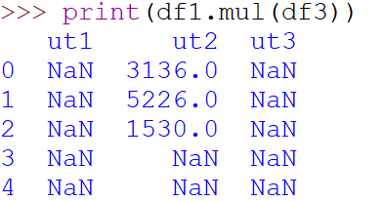
DataFrame Multiplication/Division

